Slide 1




Bell enterprise AI study: The future of AI
In partnership with:
October 2025

Slide 2

Study background and methodology
This study was conducted in partnership with Harris Poll Canada to explore the state of AI adoption among large Canadian enterprises.
Fielded in October 2025, the survey gathered responses from 207 senior IT and AI decision-makers at companies with 1,000 or more employees, spanning various sectors and provinces. The research examined current practices, future plans, organizational readiness, and strategic priorities - including data sovereignty, infrastructure readiness, and sustainability.
Respondents, referred to as “Business Leaders,” provided insights into both centralized and decentralized AI usage. “Large” businesses are defined as those with 1,000 - 4,999 employees, while “very large” refers to firms with 5,000+.
2

Slide 3

Executive summary
Canadian enterprises are entering a pivotal phase in AI adoption. With 96% of large businesses expecting AI usage to grow over the next three years, the shift is no longer speculative - it’s strategic. Yet, scaling AI remains complex.
This report outlines how Canadian organizations are navigating the opportunities and challenges of enterprise AI, with a focus on infrastructure readiness, data sovereignty, and sustainability.
While the findings confirm strong momentum behind AI adoption, they also reveal a more complex reality. Beneath the enthusiasm lie foundational challenges such as talent shortages, poor data quality, compliance risks, and infrastructure gaps.
Data sovereignty is emerging as a central concern, with many businesses prioritizing Canadian-based infrastructure to protect sensitive information. At the same time, environmental sustainability is becoming a key factor in AI planning, as organizations seek energy-efficient, low-carbon solutions that align with their broader ESG commitments.
96% of enterprises expect rapid AI growth and 75% call it a strategic priority,
but only 40% feel 'very ready' to scale citing data, talent, and compliance as key barriers.
3

Slide 4
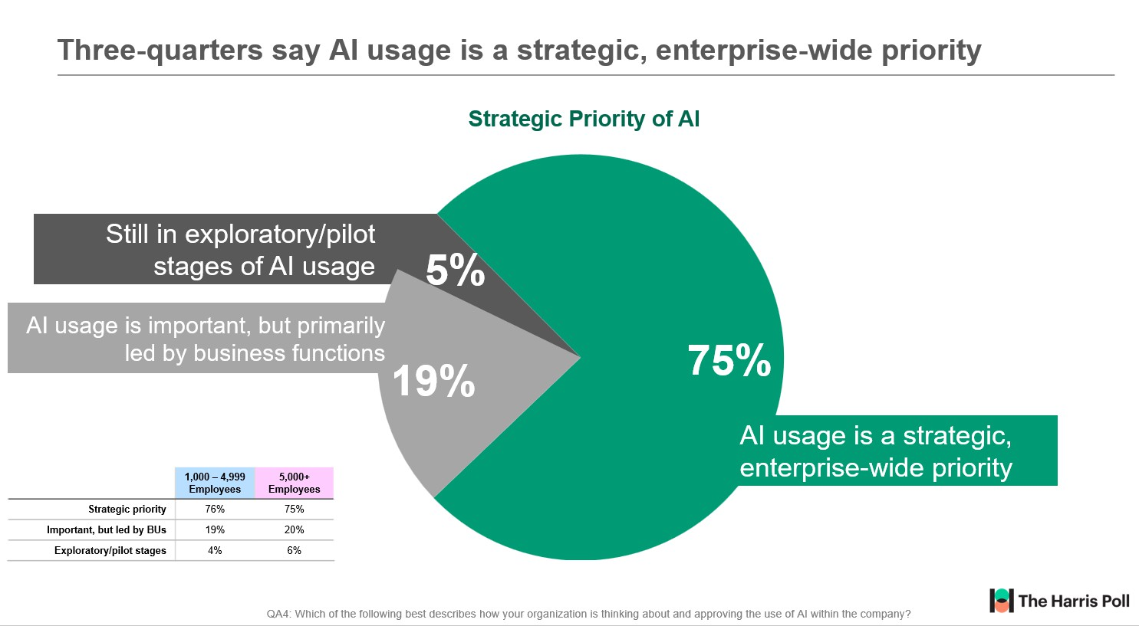
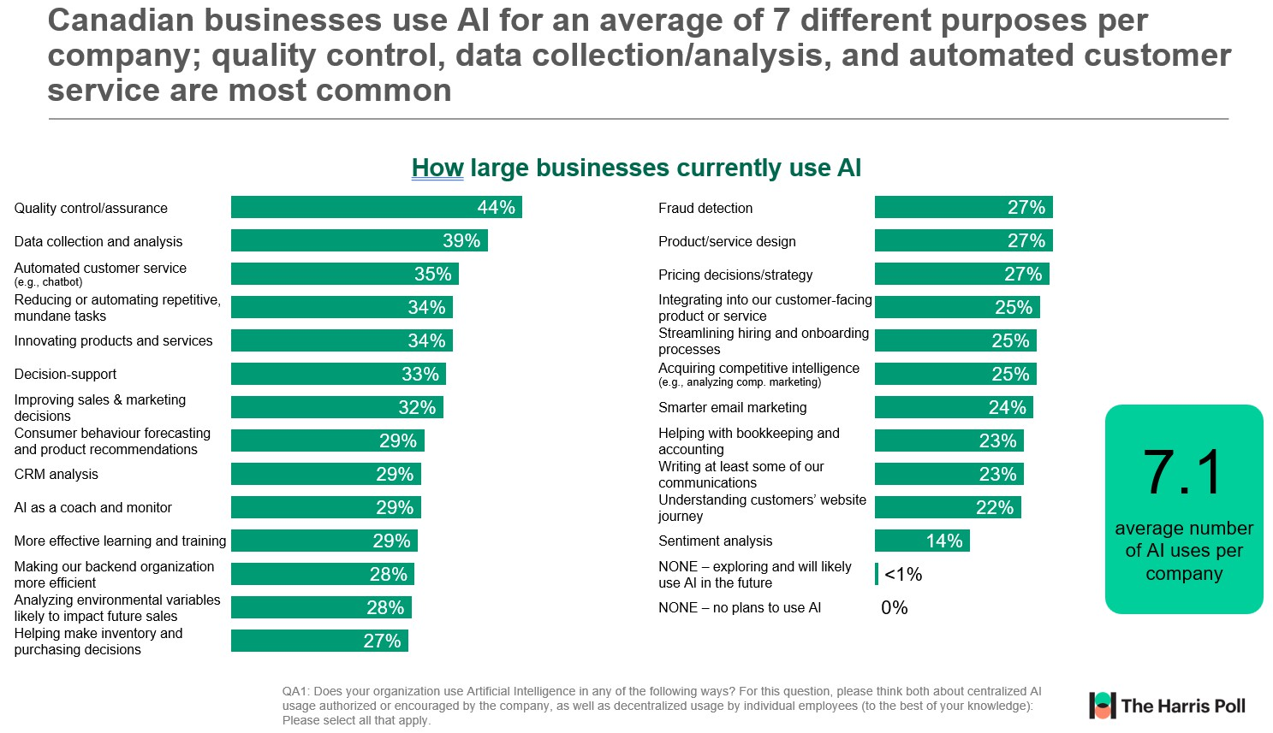
Momentum:
AI adoption is surging
Artificial Intelligence (AI) has moved from the periphery to the core of enterprise strategy for Canadian businesses. Three-quarters of organizations now view AI as a strategic, enterprise-wide priority.
This surge is not merely about experimentation; it reflects a deepening commitment to AI as a transformative force.
Click here for full size (page 12)
On average, Canadian enterprises are deploying AI across 7.1 distinct use cases, ranging from quality control and customer service to innovation and decision-making.
81% of large Canadian businesses expect to fully integrate AI into their operations within the next two years, including 30% who plan to do so within the next year.
Only 2% say they have no timeline for AI integration.
This widespread adoption signals a new era where AI is embedded into the fabric of operations, products, and services.
Click here for full size (page 13)
4

Slide 5
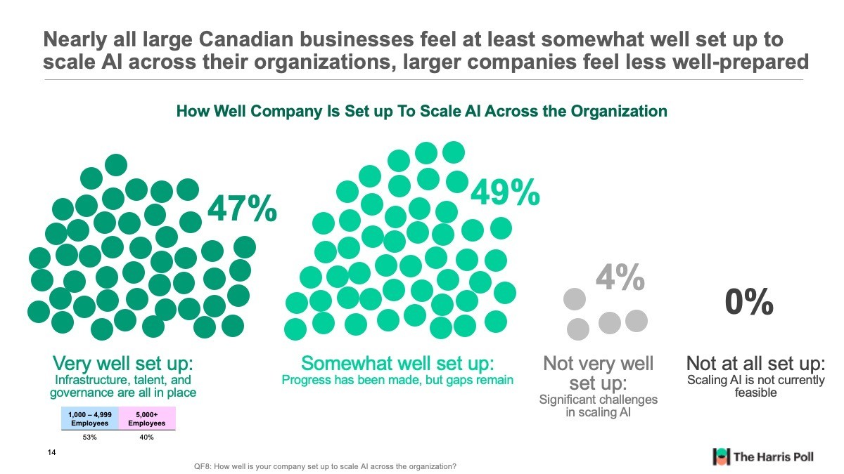
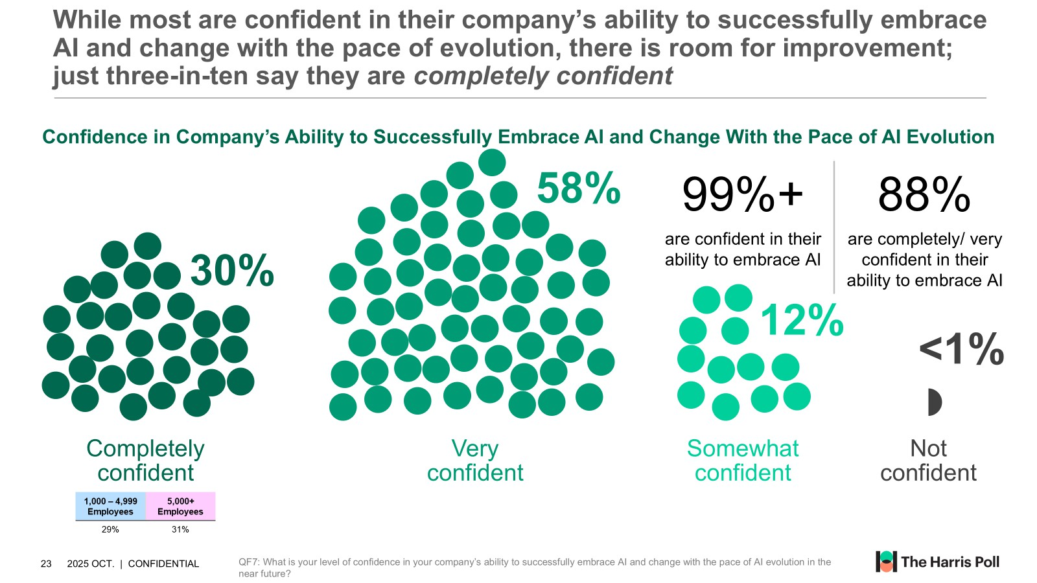
Readiness gap:
scaling confidence is low
Despite widespread adoption, only 47% of businesses feel 'very well set up' to scale AI across their organizations.
Similarly, most businesses are confident/somewhat confident in their ability to keep up with the pace of AI evolution, however, only 30% are completely confident – leaving some hesitation, more so for
larger enterprises.
Click here for full size (page 14)
Click here for full size (page 15)
5

Slide 6
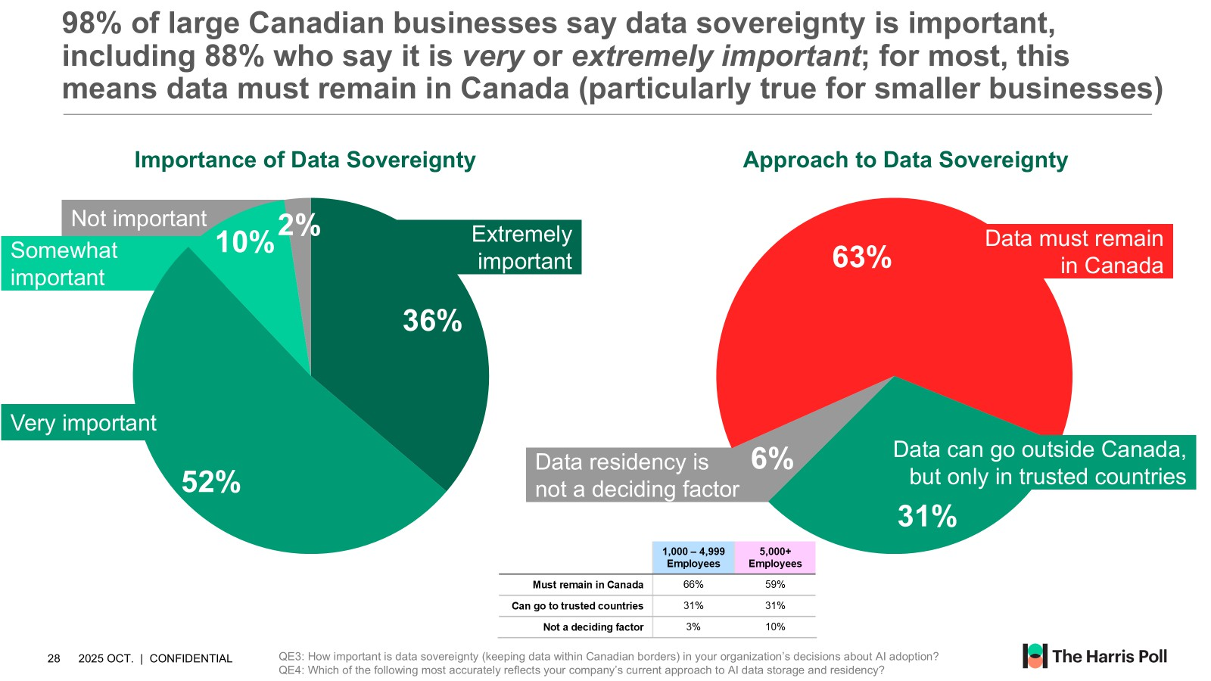
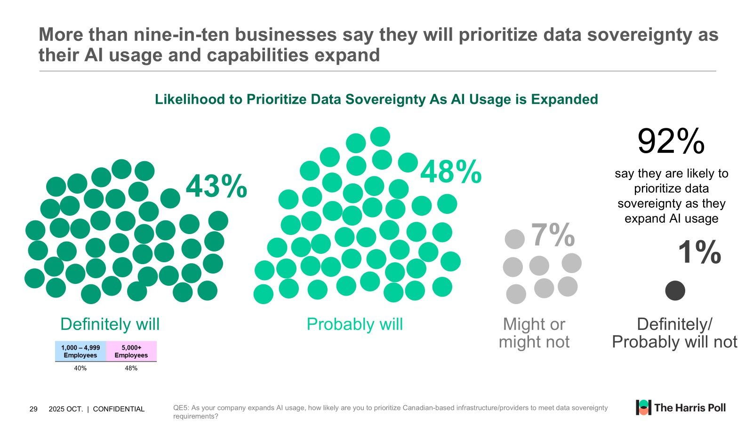
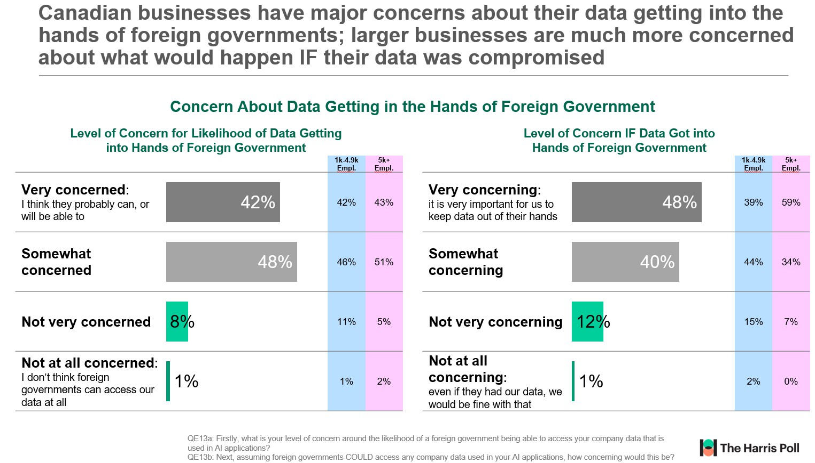
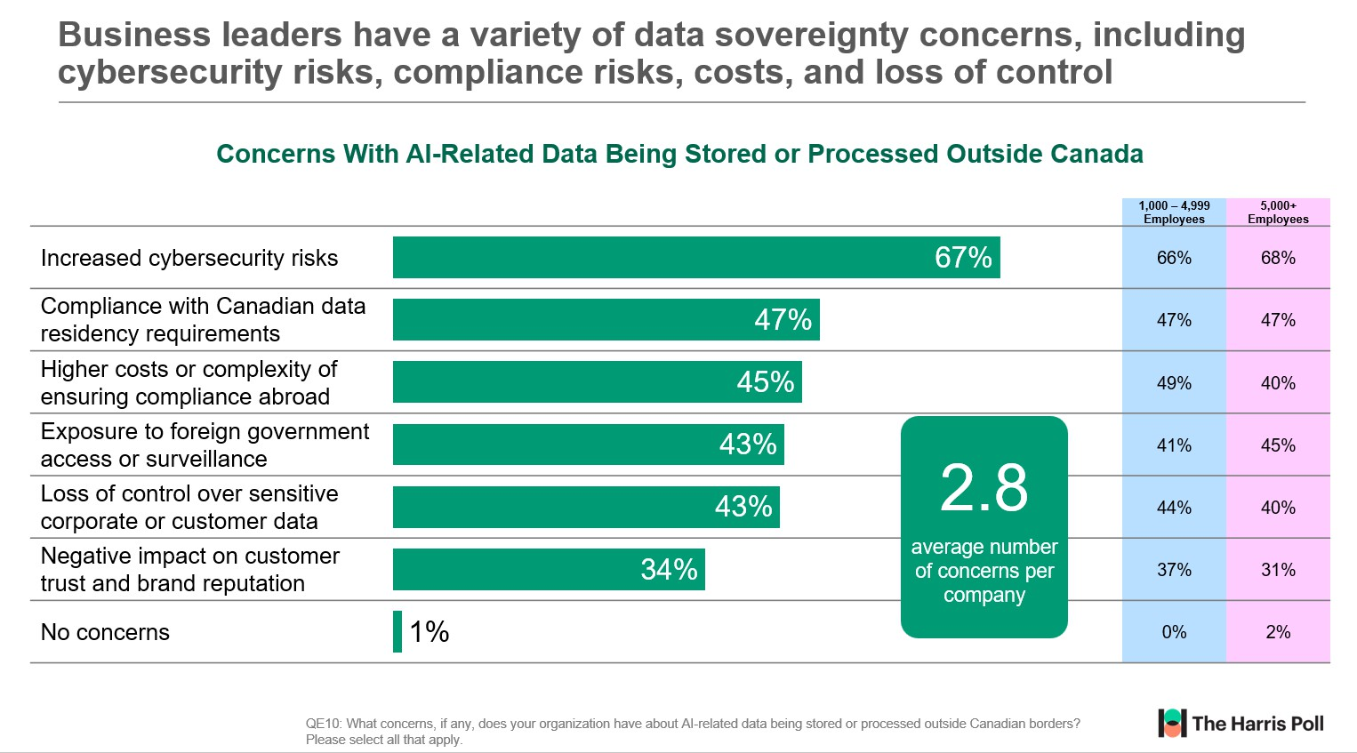
Emerging strategic priorities: sovereignty & sustainability drive decisions
Data sovereignty has emerged as a key priority with 88% of large businesses saying that it’s very/extremely important and more then 90% saying that they will prioritize data sovereignty as they continue to increase adoption.
Additionally, over 90% of businesses say keeping sensitive data within Canadian borders is valuable, with the majority of Canadian business leaders concerned about foreign governments accessing company data used in AI applications. 42% believe such access is likely and 48% saying it would be very concerning if it occurred.
Click here for full size (page 16)
Click here for full size (page 17)
Data sovereignty concerns are also a major barrier to scaling AI: Canadian business leaders report an average of 2.8 concerns per company about storing or processing AI-related data outside Canada. The top concerns include cybersecurity risk, compliance with Canadian data residency requirements, higher costs of ensuring compliance abroad, and exposure to foreign government surveillance.
Click here for full size (page 18)
Click here for full size (page 19)
6

Slide 7
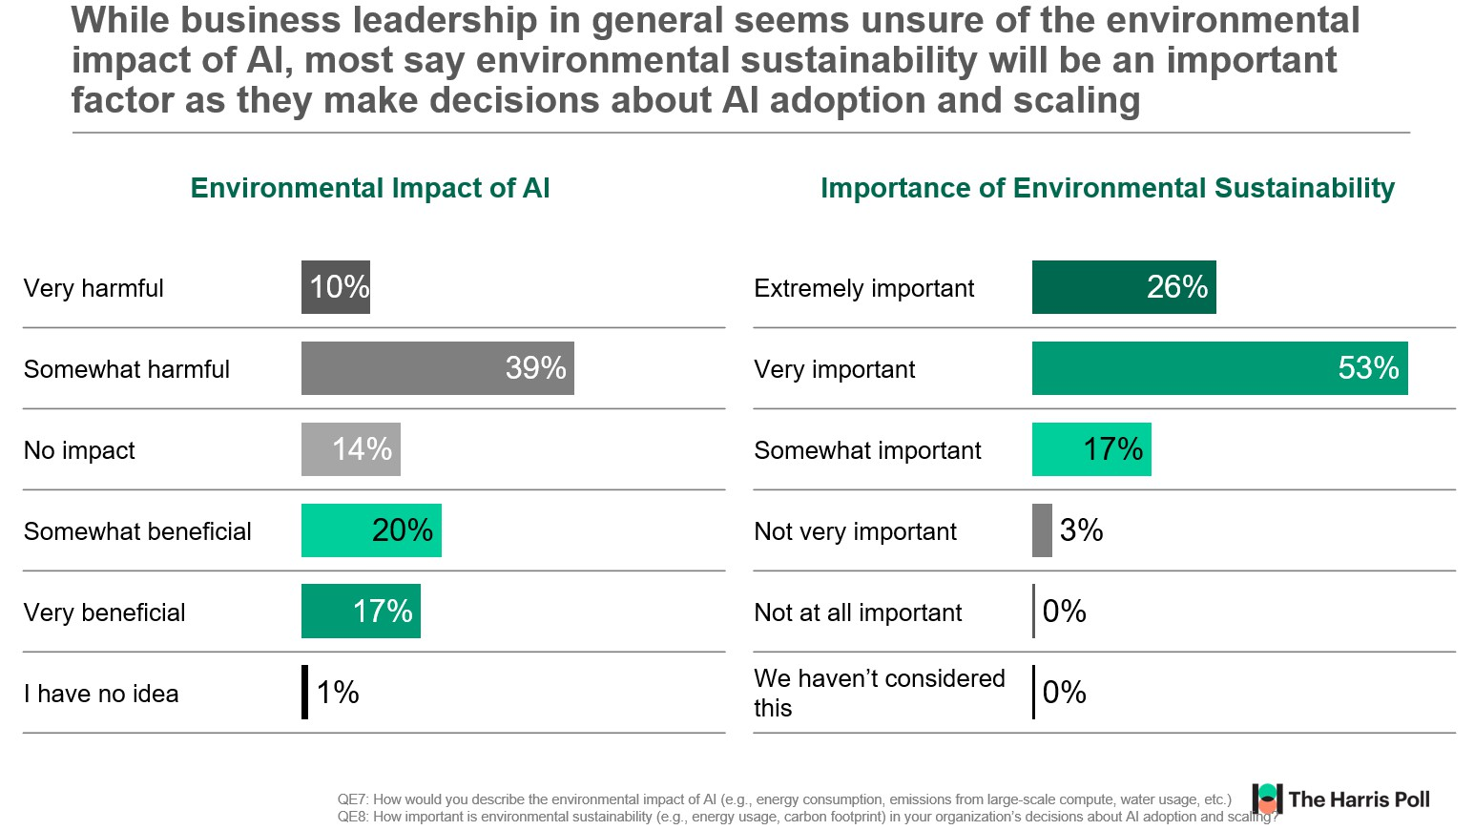
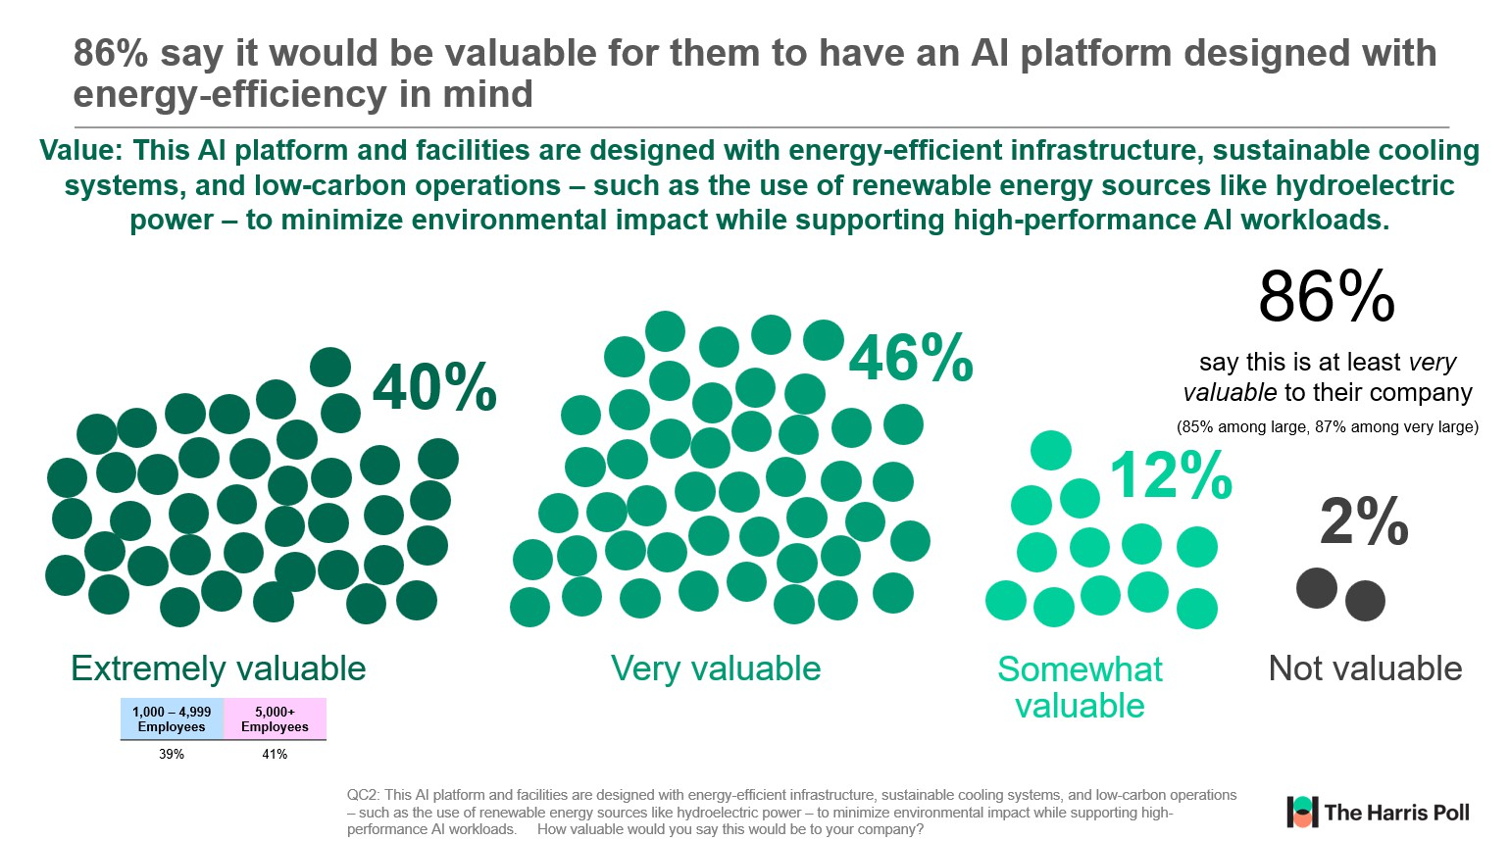
Emerging strategic priorities: sovereignty & sustainability drive decisions
Simultaneously, as AI adoption grows, environmental sustainability is becoming a key consideration for Canadian enterprises. 79% of business leaders say sustainability will influence future AI decisions—highlighting a shift toward responsible infrastructure choices that minimize energy use, emissions, and environmental footprint.
Click here for full size (page 20)
Click here for full size (page 21)
7

Slide 8
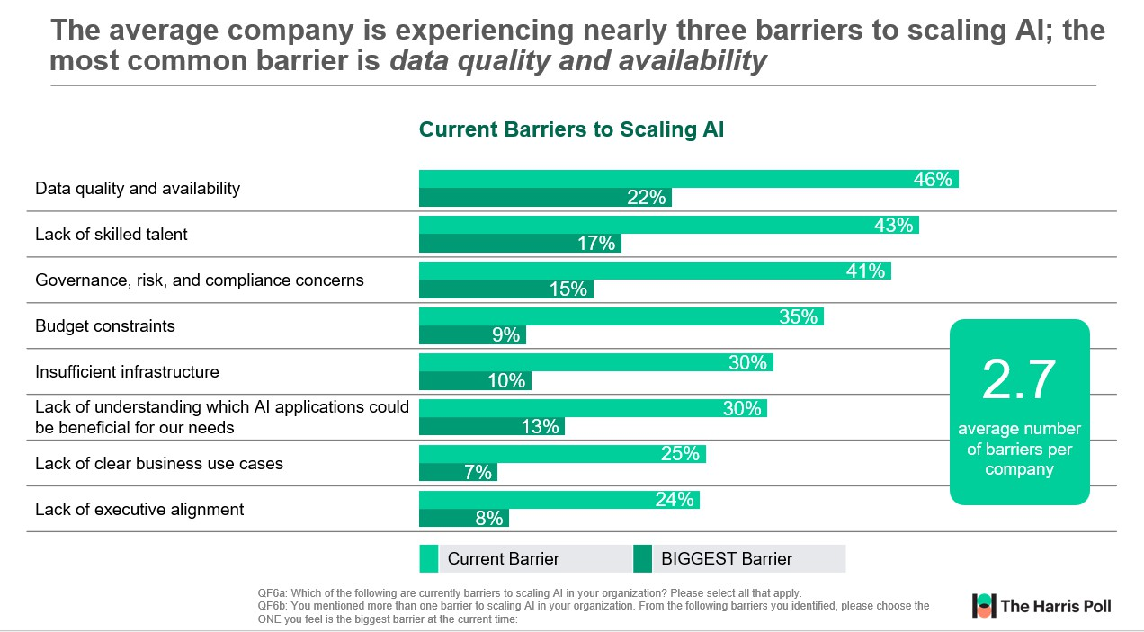
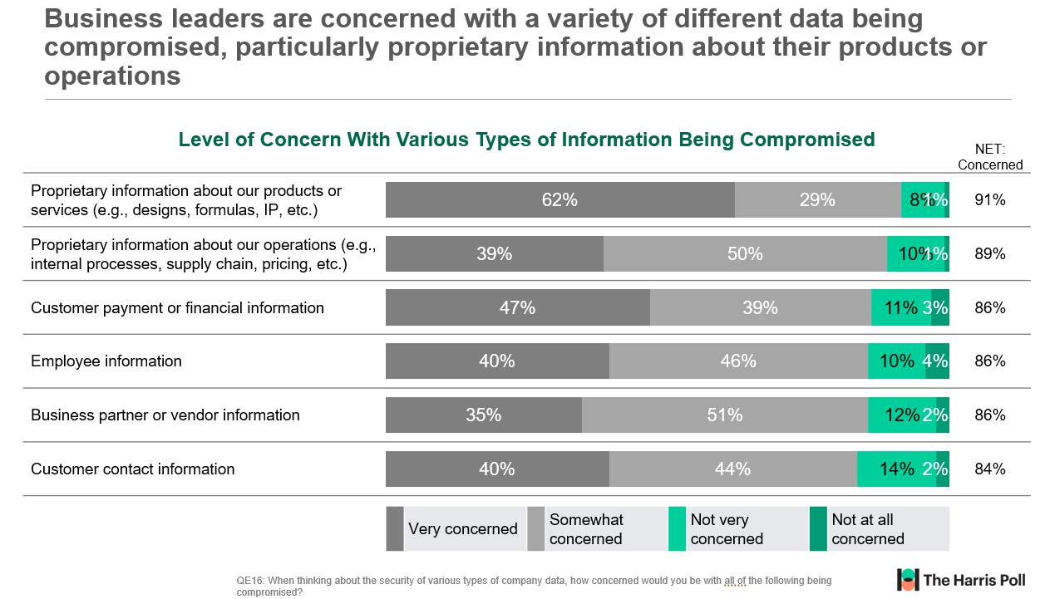
Barriers: data quality, talent, and compliance
Scaling AI is not just about ambition – it requires solving foundational issues.
Businesses face an average of 2.7 barriers with data quality and availability, talent gaps, and compliance risks leading the list.
These challenges are consistent across industries and company sizes, underscoring the need for robust infrastructure and governance frameworks.
91% of Canadian business leaders are worried about proprietary product data being compromised, and 89% express similar concern about operational data.
Click here for full size (page 22)
Additionally, 86% are concerned about the exposure of customer, employee, and vendor information—highlighting trust and risk management as critical hurdles to scaling AI.
Click here for full size (page 23)
8

Slide 9
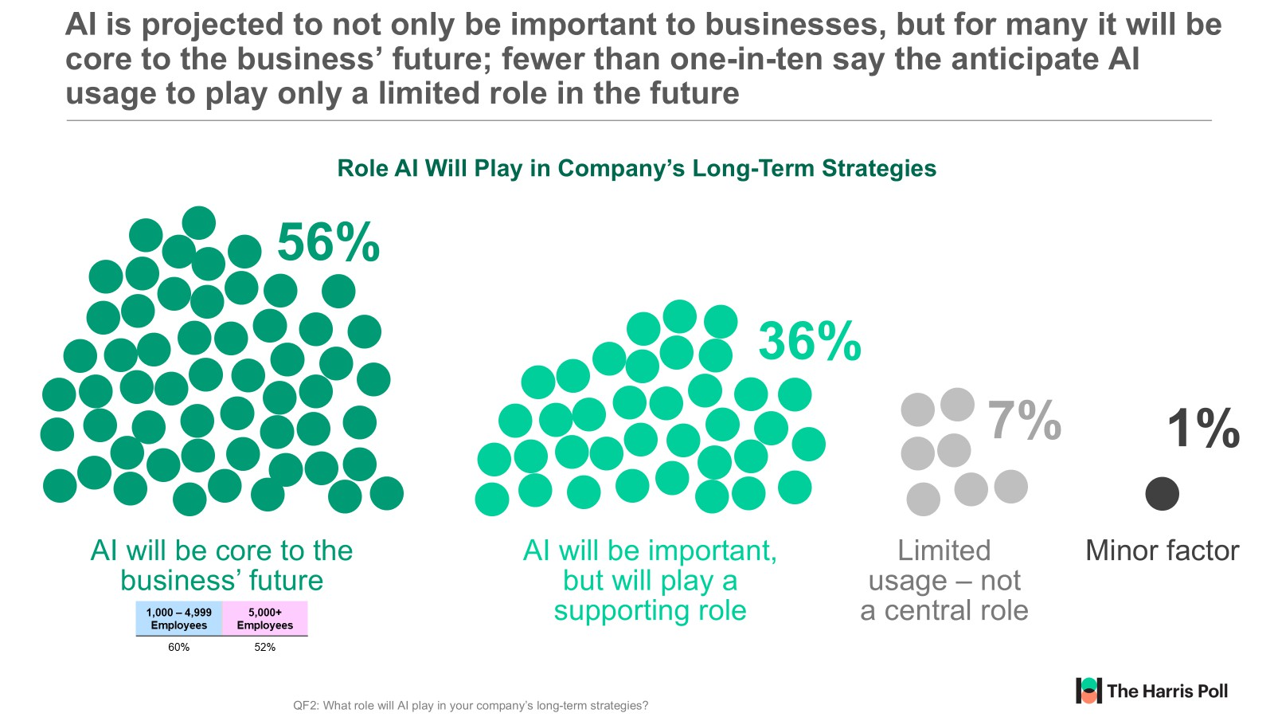
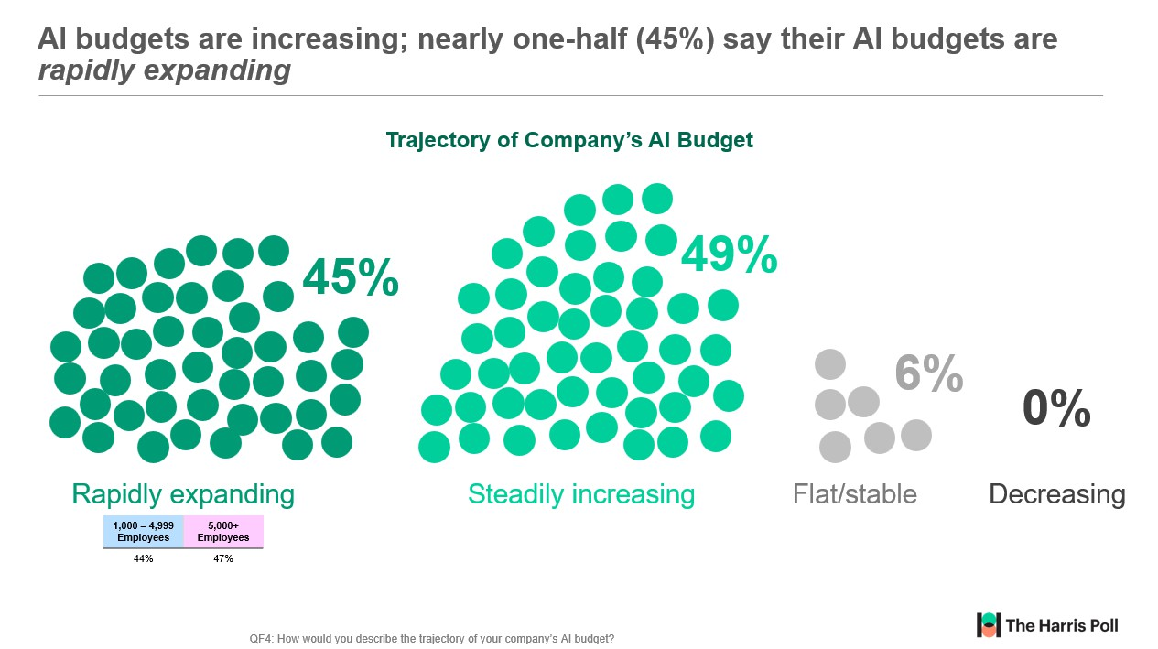
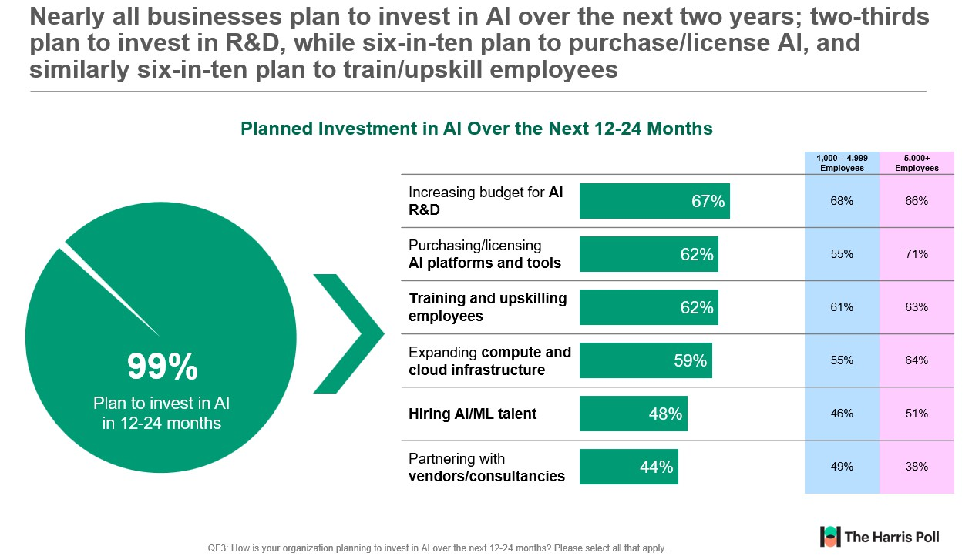
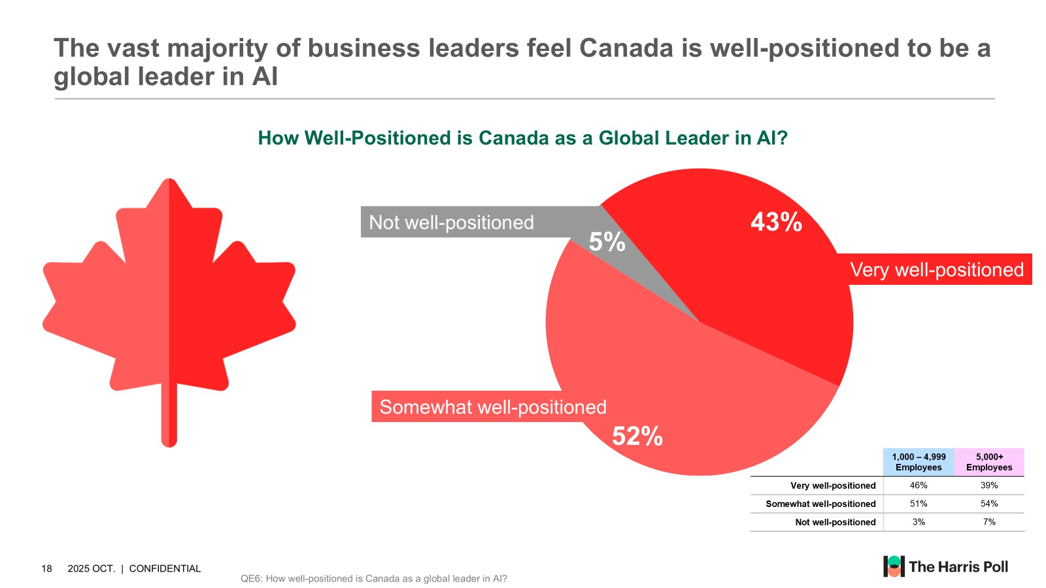
Outlook
Survey responses from Canadian business leaders confirm that AI is core to the future of businesses. It’s no longer simply something to consider – it has become a present-day strategic priority.
Adoption is accelerating rapidly, with 99% of enterprises planning continued investment over the next two years. Key areas of focus include R&D, platform licensing, workforce upskilling, infrastructure expansion and AI/ML talent acquisition.
This surge in activity is reflected in budget trends: nearly half of organizations report significant increases, with many describing their AI budgets as rapidly expanding.
Click here for full size (page 24)
Click here for full size (page 25)
Despite this momentum, fewer than half of businesses feel well-prepared to scale.
Foundational challenges such as infrastructure
readiness, data quality, and talent - persist. Data sovereignty and sustainability are now emerging as central to enterprise business AI strategy planning.
Click here for full size (page 26)
Click here for full size (page 27)
9

Slide 10
The question isn’t if AI will scale – it’s how, where, and under whose control.

Slide 11



Appendix

Slide 12
Three-quarters say AI usage is a strategic, enterprise-wide priority
Strategic Priority of AI
Still in exploratory/pilot stages of AI usage
5%
AI usage is important, but primarily
led by business functions
19%
75%
AI usage is a strategic, enterprise-wide priority
 | 1,000 – 4,999 Employees | 5,000+ Employees
Strategic priority | 76% | 75%
Important, but led by BUs | 19% | 20%
Exploratory/pilot stages | 4% | 6%
12
QA4: Which of the following best describes how your organization is thinking about and approving the use of AI within the company?

Slide 13
Canadian businesses use AI for an average of 7 different purposes per company; quality control, data collection/analysis, and automated customer service are most common
How Large Businesses Currently Use AI
Quality control/assurance
44%
Fraud detection
27%
Data collection and analysis
39%
Product/service design
27%
Automated customer service
(e.g., chatbot)
35%
Pricing decisions/strategy
27%
Reducing or automating repetitive, mundane tasks
34%
Integrating into our customer-facing product or service
25%
Innovating products and services
34%
Streamlining hiring and onboarding processes
25%
Decision-support
33%
Acquiring competitive intelligence
(e.g., analyzing comp. marketing)
25%
Improving sales & marketing decisions
32%
Smarter email marketing
24%
Consumer behaviour forecasting and product recommendations
29%
Helping with bookkeeping and accounting
Writing at least some of our
23%
7.1
CRM analysis
29%
communications
23%
AI as a coach and monitor
29%
Understanding customers’ website journey
22%
More effective learning and training
29%
Sentiment analysis
14%
average number
of AI uses per
Making our backend organization more efficient
28%
NONE – exploring and will likely use AI in the future
<1%
company
Analyzing environmental variables likely to impact future sales Helping make inventory and
28%
NONE – no plans to use AI
0%
purchasing decisions
27%
13
QA1: Does your organization use Artificial Intelligence in any of the following ways? For this question, please think both about centralized AI usage authorized or encouraged by the company, as well as decentralized usage by individual employees (to the best of your knowledge): Please select all that apply.

Slide 14


Nearly all large Canadian businesses feel at least somewhat well set up to scale AI across their organizations, larger companies feel less well-prepared
How Well Company Is Set up To Scale AI Across the Organization
49%
47%
4%
0%
Not at all set up:
Scaling AI is not currently feasible
Very well set up:
Infrastructure, talent, and governance are all in place
Somewhat well set up:
Progress has been made, but gaps remain
Not very well set up:
Significant challenges
in scaling AI
1,000 – 4,999
Employees
5,000+
Employees
53%
40%
14
QF8: How well is your company set up to scale AI across the organization?

Slide 15

While most are confident in their company’s ability to successfully embrace AI and change with the pace of evolution, there is room for improvement; just three-in-ten say they are completely confident
Confidence in Company’s Ability to Successfully Embrace AI and Change With the Pace of AI Evolution
99%+
are confident in their ability to embrace AI
88%
are completely/ very confident in their ability to embrace AI
58%
30%
12%
<1%
Completely confident
Very confident
Somewhat confident
Not confident
1,000 – 4,999
Employees
5,000+
Employees
29%
31%
15
QF7: What is your level of confidence in your company’s ability to successfully embrace AI and change with the pace of AI evolution in the near future?

Slide 16
98% of large Canadian businesses say data sovereignty is important, including 88% who say it is very or extremely important; for most, this means data must remain in Canada (particularly true for smaller businesses)
Importance of Data Sovereignty Approach to Data Sovereignty
Not important
2%
10%
Extremely important
Data must remain
in Canada
Somewhat important
63%
36%
Very important
Data residency is not a deciding factor
6%
Data can go outside Canada, but only in trusted countries
52%
31%
 | 1,000 – 4,999 Employees | 5,000+ Employees
Must remain in Canada | 66% | 59%
Can go to trusted countries | 31% | 31%
Not a deciding factor | 3% | 10%
16
QE3: How important is data sovereignty (keeping data within Canadian borders) in your organization’s decisions about AI adoption? QE4: Which of the following most accurately reflects your company’s current approach to AI data storage and residency?

Slide 17

More than nine-in-ten businesses say they will prioritize data sovereignty as their AI usage and capabilities expand
Likelihood to Prioritize Data Sovereignty As AI Usage is Expanded
92%
say they are likely to prioritize data sovereignty as they expand AI usage
1%
48%
43%
7%
Definitely will
Probably will
Might or might not
Definitely/ Probably will not
1,000 – 4,999
Employees
5,000+
Employees
40%
48%
17
QE5: As your company expands AI usage, how likely are you to prioritize Canadian-based infrastructure/providers to meet data sovereignty requirements?

Slide 18
Canadian businesses have major concerns about their data getting into the hands of foreign governments; larger businesses are much more concerned about what would happen IF their data was compromised
Concern About Data Getting in the Hands of Foreign Government
Level of Concern for Likelihood of Data Getting into Hands of Foreign Government
Level of Concern IF Data Got into Hands of Foreign Government
1k-4.9k Empl. |  |  |  | 5k+ Empl.
Very concerned: I think they probably can, or will be able to |  | 42% | 42% | 43%
Somewhat concerned |  | 48% | 46% | 51%
Not very concerned | 8% |  | 11% | 5%
Not at all concerned: I don’t think foreign governments can access our data at all | 1% |  | 1% | 2%
1k-4.9k Empl. |  |  | 5k+ Empl.
Very concerning: it is very important for us to keep data out of their hands | 48% | 39% | 59%
Somewhat concerning | 40% | 44% | 34%
Not very concerning 12% |  | 15% | 7%
Not at all concerning: _{1%} even if they had our data, we would be fine with that |  | 2% | 0%
18
QE13a: Firstly, what is your level of concern around the likelihood of a foreign government being able to access your company data that is used in AI applications?
QE13b: Next, assuming foreign governments COULD access any company data used in your AI applications, how concerning would this be?

Slide 19
Business leaders have a variety of data sovereignty concerns, including cybersecurity risks, compliance risks, costs, and loss of control
Concerns With AI-Related Data Being Stored or Processed Outside Canada
 |  |  |  |  | 1,000 – 4,999 Employees | 5,000+ Employees
Increased cybersecurity risks |  |  |  | 67% | 66% | 68%
Compliance with Canadian data residency requirements |  |  | 47% |  | 47% | 47%
Higher costs or complexity of ensuring compliance abroad |  |  | 45% |  | 49% | 40%
Exposure to foreign government access or surveillance |  |  | 43% |  | 41% | 45%
Loss of control over sensitive corporate or customer data |  |  | 43% |  | 44% | 40%
Negative impact on customer trust and brand reputation |  | 34% |  | average number of concerns per company | 37% | 31%
No concerns | 1% |  |  |  | 0% | 2%
19
QE10: What concerns, if any, does your organization have about AI-related data being stored or processed outside Canadian borders? Please select all that apply.

Slide 20
While business leadership in general seems unsure of the environmental impact of AI, most say environmental sustainability will be an important factor as they make decisions about AI adoption and scaling
Environmental Impact of AI Importance of Environmental Sustainability
Very harmful | 10% |  |  | Extremely important | 26%
Somewhat harmful |  |  | 39% | Very important |  | 53%
No impact | 14% |  |  | Somewhat important | 17%
Somewhat beneficial | 20% |  |  | Not very important | 3%
Very beneficial | 17% |  |  | Not at all important | 0%
I have no idea
1%
We haven’t considered this
0%
20
QE7: How would you describe the environmental impact of AI (e.g., energy consumption, emissions from large-scale compute, water usage, etc.)
QE8: How important is environmental sustainability (e.g., energy usage, carbon footprint) in your organization’s decisions about AI adoption and scaling?

Slide 21


86% say it would be valuable for them to have an AI platform designed with energy-efficiency in mind
Value: This AI platform and facilities are designed with energy-efficient infrastructure, sustainable cooling systems, and low-carbon operations – such as the use of renewable energy sources like hydroelectric power – to minimize environmental impact while supporting high-performance AI workloads.
86%
46%
40%
say this is at least very valuable to their company
(85% among large, 87% among very large)
12%
2%
Extremely valuable
Very valuable
Somewhat valuable
Not valuable
1,000 – 4,999
Employees
5,000+
Employees
39%
41%
21
QC2: This AI platform and facilities are designed with energy-efficient infrastructure, sustainable cooling systems, and low-carbon operations – such as the use of renewable energy sources like hydroelectric power – to minimize environmental impact while supporting high- performance AI workloads. How valuable would you say this would be to your company?

Slide 22
The average company is experiencing nearly three barriers to scaling AI; the most common barrier is data quality and availability
Current Barriers to Scaling AI
Data quality and availability
46%
22%
Lack of skilled talent
43%
17%
Governance, risk, and compliance concerns
41%
15%
Budget constraints
35%
9%
30%
2.7
Insufficient infrastructure
10%
Lack of understanding which AI applications could be beneficial for our needs
30%
13%
average number of barriers per
Lack of clear business use cases
25%
7%
company
Lack of executive alignment
24%
8%
 | Current Barrier |  | BIGGEST Barrier
22
QF6a: Which of the following are currently barriers to scaling AI in your organization? Please select all that apply.
QF6b: You mentioned more than one barrier to scaling AI in your organization. From the following barriers you identified, please choose the ONE you feel is the biggest barrier at the current time:

Slide 23
Business leaders are concerned with a variety of different data being compromised, particularly proprietary information about their products or operations
Level of Concern With Various Types of Information Being Compromised
NET:
Concerned
Proprietary information about our products or services (e.g., designs, formulas, IP, etc.)
Proprietary information about our operations (e.g., internal processes, supply chain, pricing, etc.)
 | 62% |  | 29% | 8%1% | 91%
39% |  | 50% |  | 10%1% | 89%
Customer payment or financial information
47%
39%
11% 3%
86%
Employee information
40%
46%
10% 4% 86%
Business partner or vendor information
35%
51%
12% 2% 86%
Customer contact information
40%
44%
14% 2% 84%
 | Very concerned |  | Somewhat concerned |  | Not very concerned |  | Not at all concerned
23
QE16: When thinking about the security of various types of company data, how concerned would you be with all of the following being compromised?

Slide 24

AI is projected to not only be important to businesses, but for many it will be core to the business’ future; fewer than one-in-ten say the anticipate AI usage to play only a limited role in the future
Role AI Will Play in Company’s Long-Term Strategies
56%
36%
7%
1%
AI will be core to the business’ future
AI will be important, but will play a supporting role
Limited usage – not a central role
Minor factor
1,000 – 4,999
Employees
5,000+
Employees
60%
52%
24
QF2: What role will AI play in your company’s long-term strategies?

Slide 25


AI budgets are increasing; nearly one-half (45%) say their AI budgets are
rapidly expanding
Trajectory of Company’s AI Budget
49%
45%
6%
0%
Decreasing
Rapidly expanding
Steadily increasing
Flat/stable
1,000 – 4,999
Employees
5,000+
Employees
44%
47%
25
QF4: How would you describe the trajectory of your company’s AI budget?

Slide 26
Nearly all businesses plan to invest in AI over the next two years; two-thirds plan to invest in R&D, while six-in-ten plan to purchase/license AI, and similarly six-in-ten plan to train/upskill employees
Planned Investment in AI Over the Next 12-24 Months
 |  | 1,000 – 4,999 Employees | 5,000+ Employees
Increasing budget for AI R&D | 67% | 68% | 66%
Purchasing/licensing AI platforms and tools | 62% | 55% | 71%
Training and upskilling employees | 62% | 61% | 63%
Expanding compute and cloud infrastructure | 59% | 55% | 64%
Hiring AI/ML talent | 48% | 46% | 51%
Partnering with vendors/consultancies | 44% | 49% | 38%
99%
Plan to invest in AI in 12-24 months
26
QF3: How is your organization planning to invest in AI over the next 12-24 months? Please select all that apply.

Slide 27

The vast majority of business leaders feel Canada is well-positioned to be a global leader in AI
How Well-Positioned is Canada as a Global Leader in AI?
Not well-positioned
43%
5%
Very well-positioned
Somewhat well-positioned
52%
 | 1,000 – 4,999 Employees | 5,000+ Employees
Very well-positioned | 46% | 39%
Somewhat well-positioned | 51% | 54%
Not well-positioned | 3% | 7%
27
QE6: How well-positioned is Canada as a global leader in AI?

Slide 28







Businesses deploy AI in a variety of ways, most commonly through licenses or purchase of AI software for operations; two-thirds say they are integrating AI directly into their products or services
How Large Businesses Deploy AI
68% |  | 65% |  | 65% |  | 54% |  | 45% |  | 13% |  | 1%
We license or purchase AI software for our operations (e.g., Salesforce Einstein, HubSpot AI, etc.) |  | We develop and integrate AI into our products or services |  | We allow employees to use general purpose AI tools – BUT only through a gated license (e.g., ChatGPT, Gemini, Copilot) |  | We develop and integrate AI into our internal processes |  | We allow employees to use general purpose AI tools on their own, without company license (e.g., ChatGPT, Gemini, Copilot) |  | We do not have specific policies, however we know employees are using AI and we are generally ok with it |  | We are experimenting, but not using AI formally
67% | 71% | 64% | 66% | 63% | 67% | 57% | 51% | 44% | 45% | 16% | 8% | 1% | <1%
1,000 – 4,999 Employees
5,000+ Employees
28
QA3: You mentioned your organization uses AI for at least one purpose. Which of the following ways does your company use or deploy AI? Please select all that apply.

Slide 29
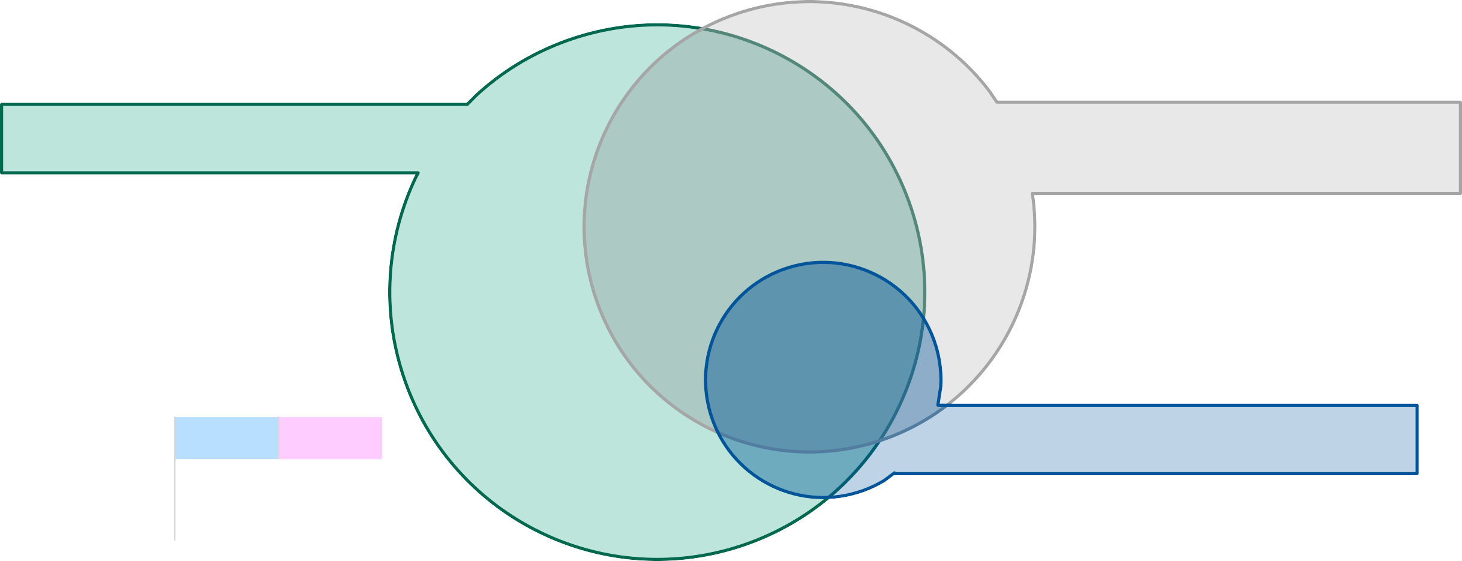
AI usage is most commonly centralized at the corporate level, however decentralization is also common; nearly half of companies (46%) deploy AI with various degrees of centralization based on the specific use cases
Centralization of AI Decision-Making
Centralized to corporate level
80%
Decentralized to business unit/departments
57%
16%
16%
32%
37%
7%
3%
 | 1,000 – 4,999 Employees | 5,000+ Employees
Centralized corporate level | 82% | 79%
Decentralized to business units | 65% | 47%
Decentralized to individuals | 18% | 10%
1% Decentralized to individuals
4%
29
QA5: Which of the following best describes how your organization makes decisions about AI? If you use a hybrid model where different AI decisions are made differently, please select any that apply:

Slide 30
Nearly all large Canadian businesses (96%) have an AI governance structure; roughly three-quarters say this structure is at the enterprise level
Whether Has AI Governance Structure
No formal structure
4%
Yes – at business unit/department level
73%
23%
Yes – at enterprise level
 | 1,000 – 4,999 Employees | 5,000+ Employees
Yes – enterprise level | 69% | 79%
Yes – BU/department level | 27% | 17%
No formal structure | 4% | 2%
30
QA6: Does your organization have an AI governance structure?

Slide 31
AI projects are more commonly standardized than run independently, however roughly half of large businesses have both standardized and independently-developed AI projects
Proportion of AI Projects that are Standardized or Independently-Developed
49%
50% 48%
42%
39% 47%
5%
4%
7% 3%
4% 2%
Mostly standardized
Mix of standardized and independent projects
Mostly independent projects
We don’t have “AI projects” per se – we just use AI
1,000 – 4,999 Employees
5,000+ Employees
31
QA7: What proportion of your AI projects are enterprise-wide, vs. independently-developed within departments?

Slide 32


Nearly all businesses anticipate increasing their use of AI over the next three years, six-in-ten of whom say the increase will be significant
Anticipated Change in AI Usage Over the Next 3 Years
57%
39%
4%
<1%
Significant increase
Moderate increase
No change
Decrease
1,000 – 4,999
Employees
5,000+
Employees
53%
62%
32
QF1a: How do you anticipate your company’s usage of AI to change over the next 3 years?

Slide 33







Businesses deploy AI in a variety of ways, most commonly through licenses or purchase of AI software for operations; two-thirds say they are integrating AI directly into their products or services
How Large Businesses Deploy AI
68% |  | 65% |  | 65% |  | 54% |  | 45% |  | 13% |  | 1%
We license or purchase AI software for our operations (e.g., Salesforce Einstein, HubSpot AI, etc.) |  | We develop and integrate AI into our products or services |  | We allow employees to use general purpose AI tools – BUT only through a gated license (e.g., ChatGPT, Gemini, Copilot) |  | We develop and integrate AI into our internal processes |  | We allow employees to use general purpose AI tools on their own, without company license (e.g., ChatGPT, Gemini, Copilot) |  | We do not have specific policies, however we know employees are using AI and we are generally ok with it |  | We are experimenting, but not using AI formally
67% | 71% | 64% | 66% | 63% | 67% | 57% | 51% | 44% | 45% | 16% | 8% | 1% | <1%
1,000 – 4,999 Employees
5,000+ Employees
33
QA3: You mentioned your organization uses AI for at least one purpose. Which of the following ways does your company use or deploy AI? Please select all that apply.

Slide 34
More than nine-in-ten business leaders say global and geopolitical factors have increased the importance of keeping their data in Canada
How Global & Geopolitical Factors Have Influenced the Importance of AI Data Sovereignty
52%
Significantly increased the importance of keeping our data in Canada
42%
Somewhat increased the importance of keeping our data in Canada
6%
Decreased the importance of keeping our data in Canada
<1%
No change
34
QE9: How have global and geopolitical factors (e.g., international regulations, trade tensions, cross-border data policies, etc.) influenced the importance of data sovereignty in your organization’s AI strategy?

Slide 35
Eight-in-ten say they project AI to be fully integrated into their operations within the next two years; just 2% do not have an integration timeline
Projected Timeline for Full AI Integration with Operations
 |  |  |  | 1,000 – 4,999 Employees | 5,000+ Employees
Within the next year |  | 30% |  | 29% | 33%
Within the next two years |  |  | 51% | 55% | 46%
Within the next five years | 14% |  |  | 12% | 16%
Within the next ten years | 2% |  |  | 2% | 2%
More than ten years | 0% |  |  | 1% | 0%
We do not have a timeline for this | 2% |  |  | 2% | 2%
35
QE11: What is your organization’s projected timeline for full AI integration into your operations?

Slide 36
Just one-quarter say a good AI project idea would be approved immediately; most say there would be some delay as they assess the merits and risks of the project
Average Timeline For AI Project Approval
 |  |  |  | 1,000 – 4,999 Employees | 5,000+ Employees
If it was a good idea, it would be approved immediately |  | 23% |  | 22% | 23%
A month or less |  |  | 35% | 37% | 32%
Two months or less |  | 26% |  | 24% | 29%
Six months or less | 11% |  |  | 9% | 13%
A year or less | 5% |  |  | 7% | 3%
More than a year | 0% |  |  | 0% | 0%
It likely would not get approved | <1% |  |  | 1% | 0%
36
QE11: What is your organization’s projected timeline for full AI integration into your operations?

Slide 37
Seven-in-ten say they were aware of the CLOUD Act; more than nine-in-ten are concerned about their data, given the CLOUD Act
CLOUD Act Awareness and Concern
Awareness of CLOUD Act Before Today Concern About Data After Reading CLOUD Act
No
40%
Very concerned
29%
54%
Somewhat concerned
Yes
Not very concerned
6%
71%
Not at all concerned
<1%
37
QE13a: Firstly, what is your level of concern around the likelihood of a foreign government being able to access your company data that is used in AI applications?
QE13b: Next, assuming foreign governments COULD access any company data used in your AI applications, how concerning would this be?

Slide 38
Business leaders are concerned with a variety of different data being compromised, particularly proprietary information about their products or operations
Level of Concern With Various Types of Information Being Compromised
NET:
Concerned
Proprietary information about our products or services (e.g., designs, formulas, IP, etc.)
Proprietary information about our operations (e.g., internal processes, supply chain, pricing, etc.)
 | 62% |  | 29% | 8%1% | 91%
39% |  | 50% |  | 10%1% | 89%
Customer payment or financial information
47%
39%
11% 3%
86%
Employee information
40%
46%
10% 4% 86%
Business partner or vendor information
35%
51%
12% 2% 86%
Customer contact information
40%
44%
14% 2% 84%
 | Very concerned |  | Somewhat concerned |  | Not very concerned |  | Not at all concerned
38
QE16: When thinking about the security of various types of company data, how concerned would you be with all of the following being compromised?

